Slide 1
CURVE FITTING

Slide 2
CURVE FITTING Part 5
Describes techniques to fit curves (curve fitting) to discrete data to obtain intermediate estimates.
There are two general approaches two curve fitting:
Data exhibit a significant degree of scatter. The strategy is to derive a single curve that represents the general trend of the data.
Data is very precise. The strategy is to pass a curve or a series of curves through each of the points.
In engineering two types of applications are encountered:
Trend analysis. Predicting values of dependent variable, may include extrapolation beyond data points or interpolation between data points.
Hypothesis testing. Comparing existing mathematical model with measured data.

Slide 3
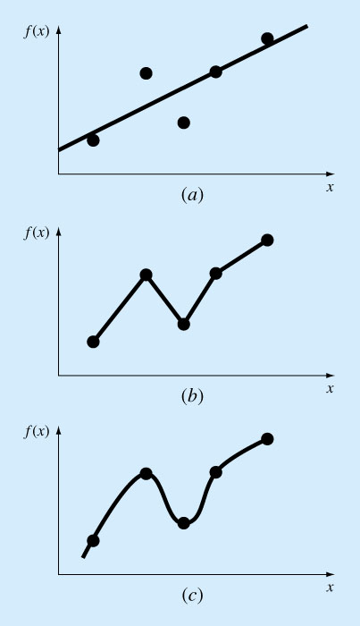
Figure PT5.1

Slide 4
Mathematical Background
Simple Statistics/
In course of engineering study, if several measurements are made of a particular quantity, additional insight can be gained by summarizing the data in one or more well chosen statistics that convey as much information as possible about specific characteristics of the data set.
These descriptive statistics are most often selected to represent
The location of the center of the distribution of the data,
The degree of spread of the data.

Slide 5
Arithmetic mean. The sum of the individual data points (yi) divided by the number of points (n).
Standard deviation. The most common measure of a spread for a sample.
or

Slide 6
Variance. Representation of spread by the square of the standard deviation.
Coefficient of variation. Has the utility to quantify the spread of data.
Degrees of freedom

Slide 7
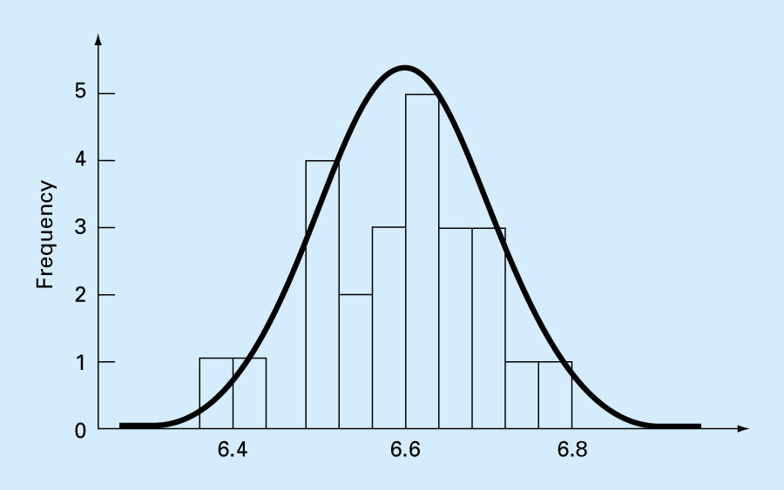
Figure PT5.2

Slide 8
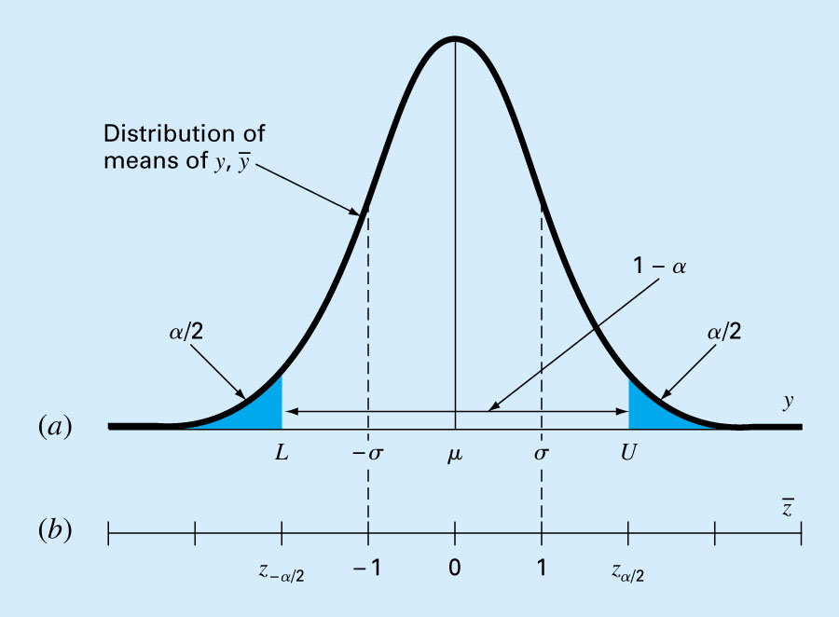
Figure PT5.3

Slide 9
Least Squares Regression
Linear Regression
Fitting a straight line to a set of paired observations: (x₁, y₁), (x₂, y₂),…,(x_{n}, y_{n}).
y=a₀+a₁x+e
a₁- slope
a₀- intercept
e- error, or residual, between the model and the observations

Slide 10
Criteria for a “Best” Fit/
Minimize the sum of the residual errors for all available data:
n = total number of points
However, this is an inadequate criterion, so is the sum of the absolute values

Slide 11
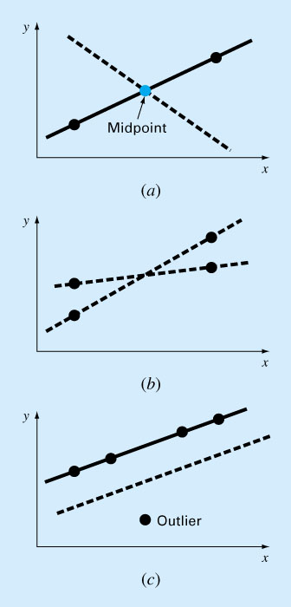
Figure 17.2

Slide 12
Best strategy is to minimize the sum of the squares of the residuals between the measured y and the y calculated with the linear model:
Yields a unique line for a given set of data.

Slide 13
Least-Squares Fit of a Straight Line/
Normal equations, can be solved simultaneously
Mean values

Slide 14
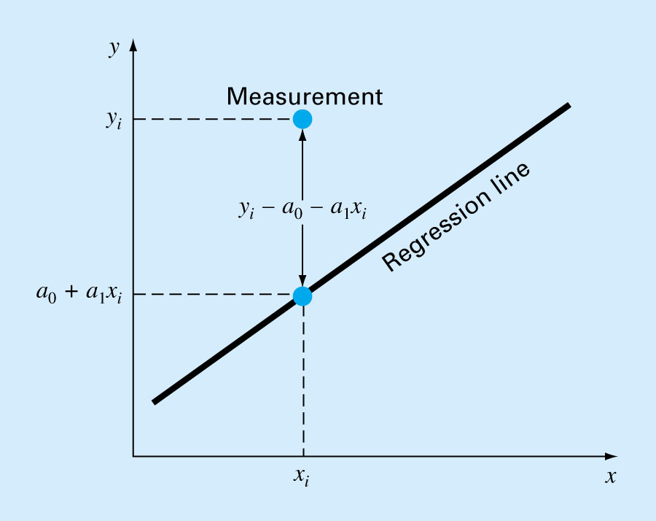
Figure 17.3

Slide 15
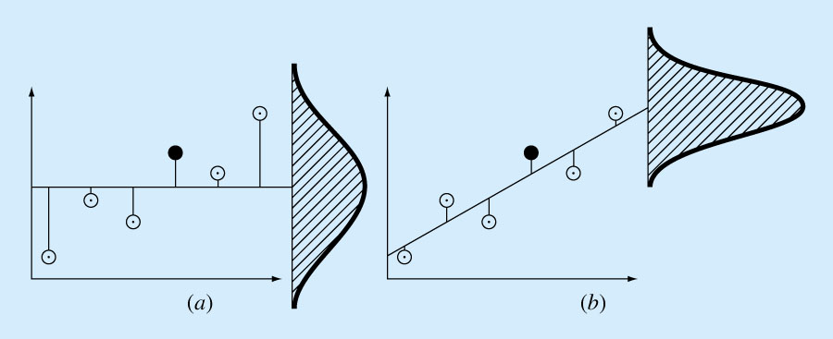
Figure 17.4

Slide 16
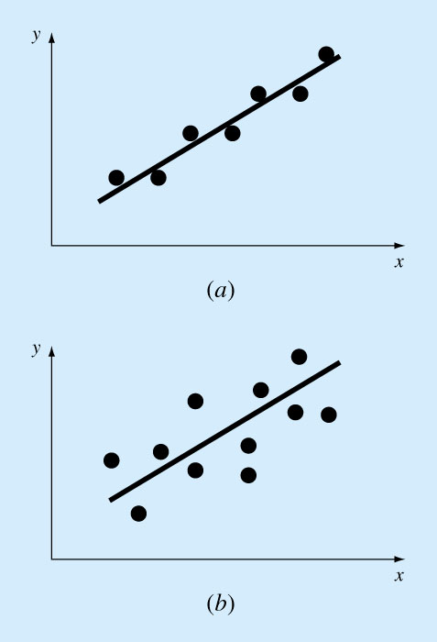
Figure 17.5

Slide 17
“Goodness” of our fit/
If
Total sum of the squares around the mean for the dependent variable, y, is S_{t}
Sum of the squares of residuals around the regression line is S_{r}
S_{t}-S_{r} quantifies the improvement or error reduction due to describing data in terms of a straight line rather than as an average value.
r²-coefficient of determination
Sqrt(r²) – correlation coefficient

Slide 18
For a perfect fit
S_{r}=0 and r=r²=1, signifying that the line explains 100 percent of the variability of the data.
For r=r²=0, S_{r}=S_{t}, the fit represents no improvement.

Slide 19
Polynomial Regression
Some engineering data is poorly represented by a straight line. For these cases a curve is better suited to fit the data. The least squares method can readily be extended to fit the data to higher order polynomials (Sec. 17.2).

Slide 20
General Linear Least Squares
Minimized by taking its partial derivative w.r.t. each of the coefficients and setting the resulting equation equal to zero

Slide 21

Curve Fitting
P M V Subbarao
Professor
Mechanical Engineering Department
An Optimization Method to Develop A Model for Instrument…..

Slide 22
Less Unknowns & More Equations
y
x

Slide 23
Quantifying error in a curve fit
positive or negative error have the same value (data point is above or below the line)
Weight greater errors more heavily

Slide 24
Less Unknowns & More Equations
y
x

Slide 25
Less Unknowns & More Equations
x

Slide 26
Hunting for A Shape & Geometric Model to Represent A Data Set

Slide 30
Minimum Energy Method : Least Squares Method
If our fit is a straight line

Slide 31
The ‘best’ line has minimum error between line and data points
This is called the least squares approach, since square of the error is minimized.
Take the derivative of the error with respect to a and b, set each to zero

Slide 32
Solve for the a and b so that the previous two equations both = 0

Slide 33
put these into matrix form

Slide 35
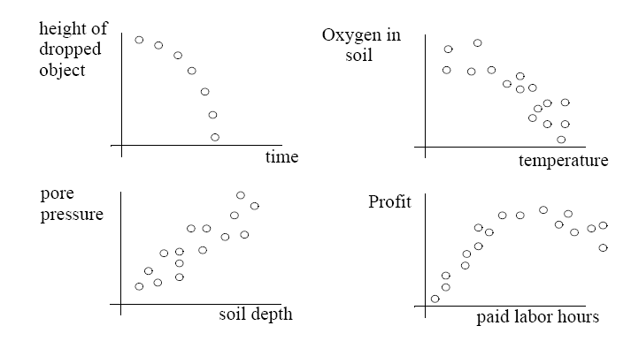
Is a straight line suitable for each of these cases ?

Slide 36
The Least-Squares m^{th} Degree Polynomials
When using an m^{th} degree polynomial
to approximate the given set of data, (x₁,y₁), (x₂,y₂)…… (x_{n},y_{n}), where n ≥ m, the best fitting curve has the least square error, i.e.,

Slide 37
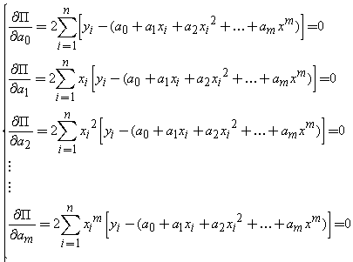
To obtain the least square error, the unknown coefficients a₀, a₁, …. and a_{m} must yield zero first derivatives.

Slide 38
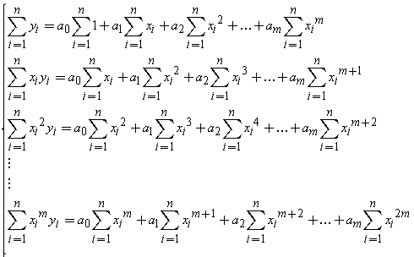
Expanding the previous equations, we have
The unknown coefficients can hence be obtained by solving the above linear equations.

Slide 39
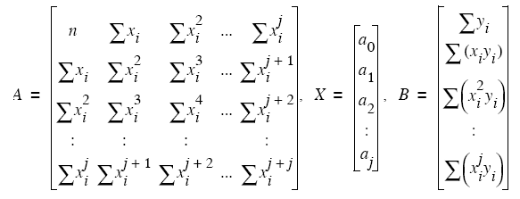

No matter what the order j, we always get equations LINEAR with respect to the coefficients.
This means we can use the following solution method

Slide 40
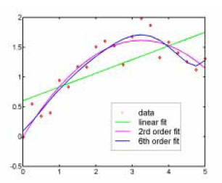
Selection of Order of Fit
2nd and 6th order look similar, but 6th has a ‘squiggle to it.
Is it Required or not?

Slide 41
Under Fit or Over Fit: Picking An appropriate Order
Underfit - If the order is too low to capture obvious trends in the data
Overfit - over-doing the requirement for the fit to ‘match’ the data trend (order too high)
Polynomials become more ‘squiggly’ as their order increases.
A ‘squiggly’ appearance comes from inflections in function
General rule: pick a polynomial form at least several orders lower than the number of data points.
Start with linear and add extra order until trends are matched.

Slide 42
Linear Regression Analysis
Linear curve fitting
Polynomial curve fitting
Power Law curve fitting: y=ax^{b}
ln(y) = ln(a)+bln(x)
Exponential curve fitting: y=ae^{bx}
ln(y)=ln(a)+bx

Slide 43
Goodness of fit and the correlation coefficient
A measure of how good the regression line as a representation of the data.
It is possible to fit two lines to data by
(a) treating x as the independent variable : y=ax+b, y as the dependent variable or by
(b) treating y as the independent variable and x as the dependent variable.
This is described by a relation of the form x= a'y +b'.
The procedure followed earlier can be followed again to find best values of a’ and b’.

Slide 44
put these into matrix form

Slide 45
Recast the second fit line as:
is the slope of this second line, which not same as the first line

Slide 46
The ratio of the slopes of the two lines is a measure of how good the form of the fit is to the data.
In view of this the correlation coefficient ρ defined through the relation

Slide 49
Correlation Coefficient
The sign of the correlation coefficient is determined by the sign of the covariance.
If the regression line has a negative slope the correlation coefficient is negative
while it is positive if the regression line has a positive slope.
The correlation is said to be perfect if ρ = ± 1.
The correlation is poor if ρ ≈ 0.
Absolute value of the correlation coefficient should be greater than 0.5 to indicate that y and x are related!
In the case of a non-linear fit a quantity known as the index of correlation is defined to determine the goodness of the fit.
The fit is termed good if the variance of the deviates is much less than the variance of the y’s.
It is required that the index of correlation defined below to be close to ±1 for the fit to be considered good.

Slide 51
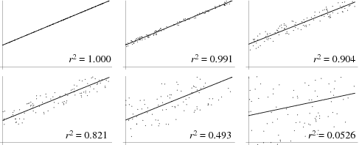
ρ²=1.000
ρ²=0.991
ρ²=0.904
ρ²=0.821
ρ²=0.493
ρ²=0.0526

Slide 52
Multi-Variable Regression Analysis
Cases considered so far, involved one independent variable and one dependent variable.
Sometimes the dependent variable may be a function of more than one variable.
For example, the relation of the form
is a common type of relationship for flow through an Orifice or Venturi.
mass flow rate is a dependent variable and others are independent variables.

Slide 53
Set up a mathematical model as:
Taking logarithm both sides
Simply:
where y is the dependent variable, l, m, n, o and p are independent variables and a, b, c, d, e are the fit parameters.

Slide 54
The least square method may be used to determine the fit parameters.
Let the data be available for set of N values of y, l, m, n, o, p values.
The quantity to be minimized is given by
What is the permissible value of N ?

Slide 55
The normal linear equations are obtained by the usual process of setting the first partial derivatives with respect to the fit parameters to zero.

Slide 56
These equations are solved simultaneously to get the six fit parameters.
We may also calculate the index of correlation as an indicator of the quality of the fit.
This calculation is left to you!

